Slide 1

Artificial Illusion
The Art of Deepfake Technology

Slide 2


OUR TEAM
Jawaher Alkhamis
Dhoha Almubayedh

Slide 3

TABLE OF CONTENTS
01
Introduction
02
Implement & challenge
03
Training Results
04
Implementation Results and Benchmarking

Slide 4


INTRODUCTION

Slide 5

Type
Deepfake
Model
MesoNet
Objectives
Enhance,Modify,Generalize

Slide 6
Limitations
Resources,Time, References
Gaps
Missing Parts in the Base-Model

Slide 7
Implemntation and Challenges

Slide 8

Implementations
Evaluation
Data Collection
Preprocessing
Training
Self-Gathered
FaceForensics++
Deep Fake Detection Challenge
Original Dataset
Loss
Accuracy
Classification Report
Confusion Matrix
Real World effectiveness
Epochs 60 – 80 ~ 100
Batches 16 – 32 - 64
Learn Rate 0.001
Decay Weight 1e-5

Slide 9
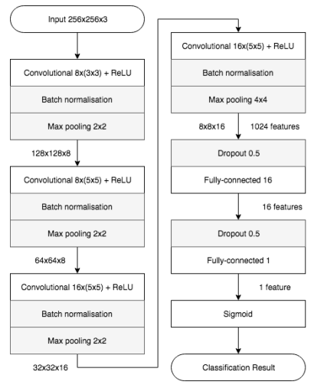
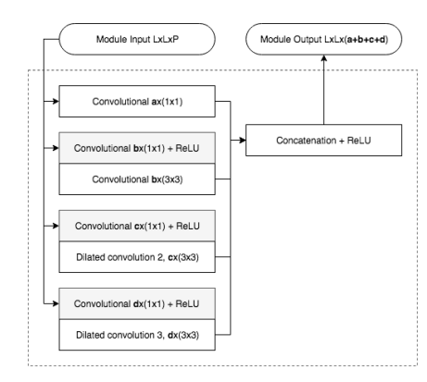
Meso4 Base-line model
Model Structure
Enhancement
MesoInception4 Base-line model
Enhanced Loss Function Choice
Enhanced Optimization
Data Augmentation

Slide 10
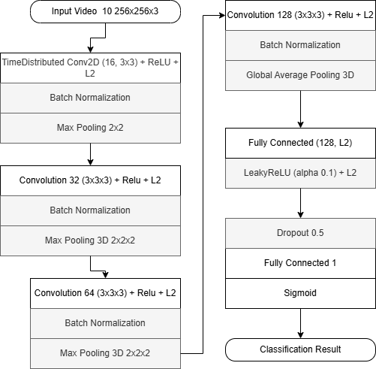
Integrated Model
Meso3D Model Structure

Slide 11
Computation Load
Incomplete Training
Unclear Output
Challenges
Took an average of 2 ~ 8 hours to preprocess videos for small dataset size
Took an average of 1 ~ 2 hours to preprocess images
The Training code was missing from the base-line
Searching & developing the base-line train code
The base-line output was unclear

Slide 12
Base-Dataset
Incompatible videos
Errors
Challenges
The Base-line dataset source initially wasn’t available
The results wasn’t that of a good compatibility to videos
Some minor and major error appear after long time of running

Slide 13
Training Results

Slide 14

Training Datasets Roadmap
Meso4 (Enhanced version)
Original DeepFake Dataset (image-based).
Dataset of 19456 images (cropped frames from videos).
Meso-Inception4 (Enhanced version)
Original DeepFake Dataset (image-based.
Dataset of 19456 images (cropped frames from videos).
Meso3D (Integrated version)
FaceForensics++ DeepFake-based videos Dataset.
Dataset of 375 deepfake videos.

Slide 15
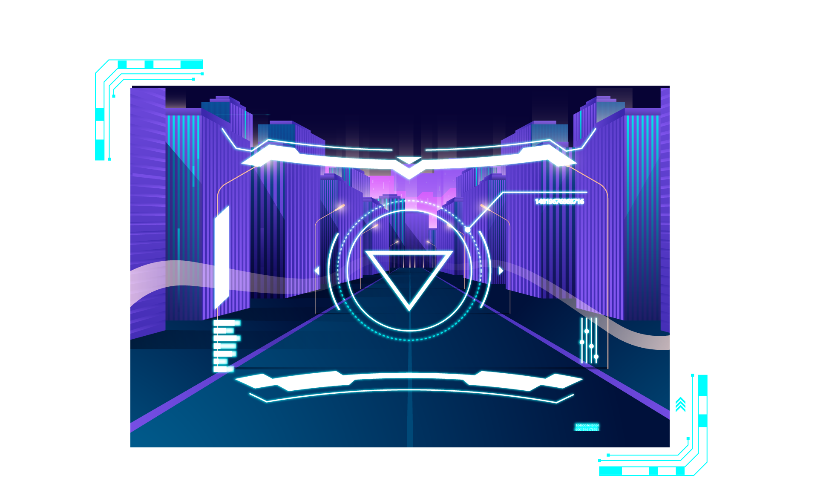
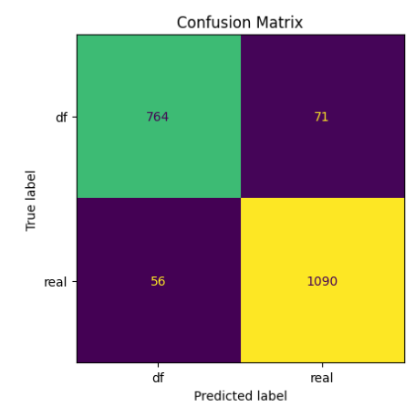
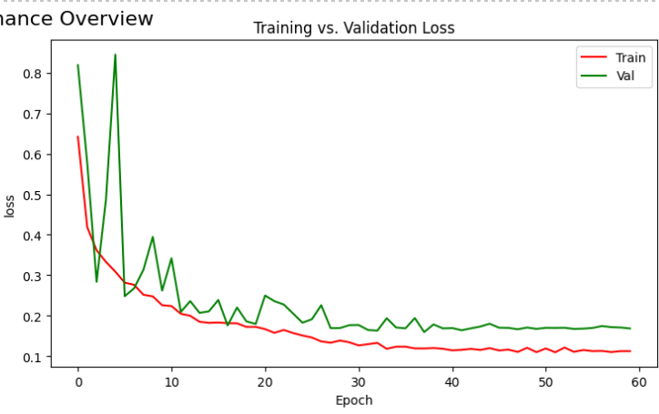
Meso-4 Refined
Validation Accuracy = 93.50% Test Accuracy = 92.41%

Slide 16
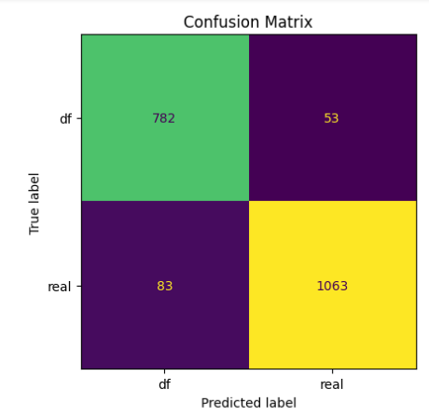
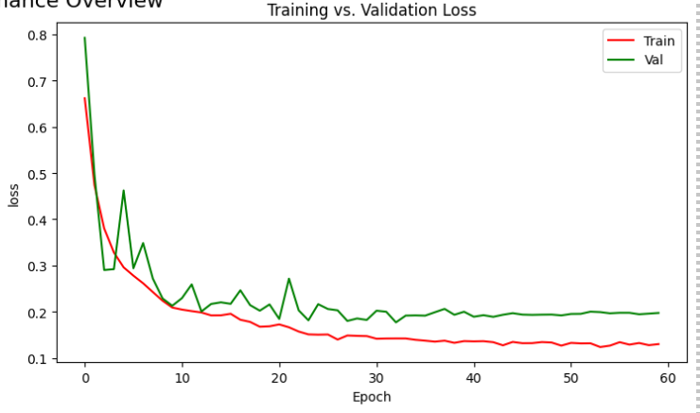
MesoInception-4 Refined
Validation Accuracy = 93.13% Test Accuracy = 94.1%

Slide 17
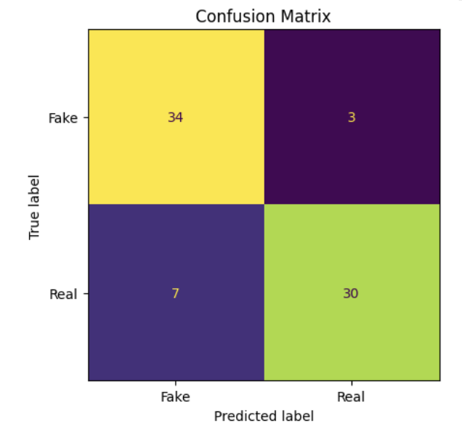
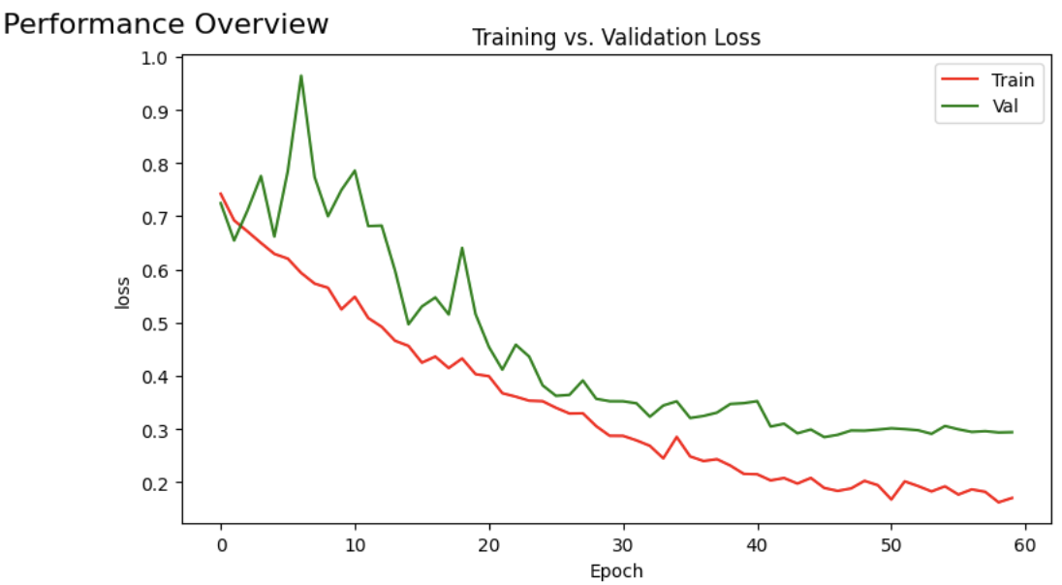
Meso-3D
Validation Accuracy = 86.49% Test Accuracy = 82.89%

Slide 18
Implementation Results & Benchmarking

Slide 19
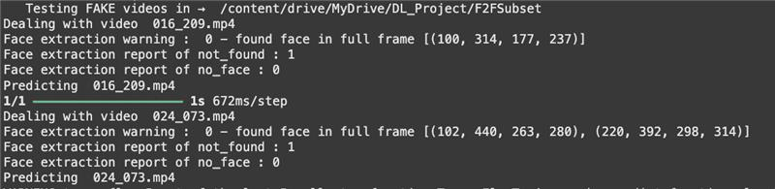
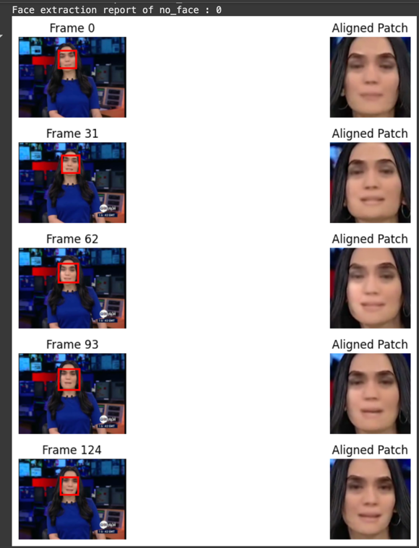
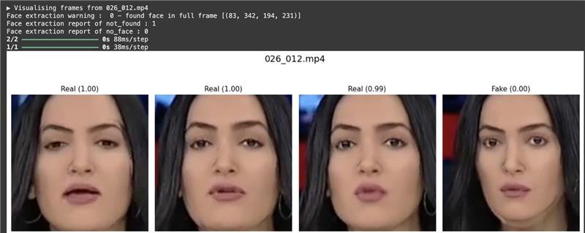
Base-line model
Refined Model
Face Extraction & Detection

Slide 20
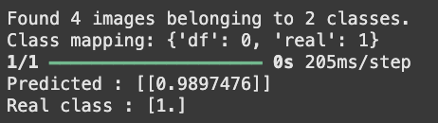
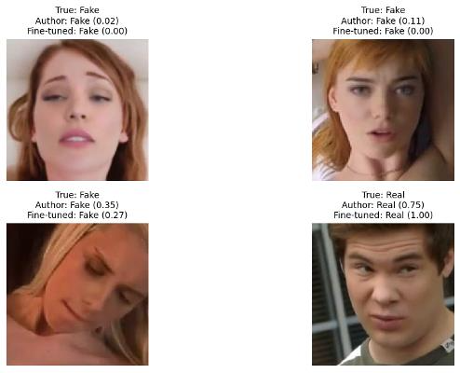

Base-line model
Refined Model
Fake Detection

Slide 21

Fake Detection Benchmarking

Slide 22
Meso4 Model
Comparison of Test Results on Deepfake Dataset
Loss
Accuracy
Base-Model Weights
0.086
89.4%
Fine Tuned Weights
0.057
92.4%

Slide 23
Dataset
50 Deepfake Videos Comparison
Model
Base-Model Detection Rate
Refine-Model
Detection Rate
Meso-4
28%
72%
FaceForensics++ Dataset
12%
64%
Meso-Inception4
Detection Rate is how many of the 50 fake videos extracted from FaceForensics++ were detected by the model

Slide 24
Dataset
50 Deepfake Videos Comparison
Model
Base-Model Detection Rate
Refine-Model
Detection Rate
Meso-4
14.5%
73.5%
Celeb-df Dataset
0.0%
48.2%
Meso-Inception4
Detection Rate is how many of the 50 fake videos extracted from celeb-df dataset were detected by the model

Slide 25
Future Directions

Slide 26
Improve Existing face Extraction Methodology
Road to Generalization
Ensemble Learning
Refine Meso3D
Future Directions

Slide 27
Thank you for Listening
Q & A

